Slide 1
Managing People by the Numbers

Slide 2
Which is Most Important?
Skill
Knowledge
Attitude
Notes:
When it comes to performance, which is most important; skill, knowledge or attitude?
lets consider a scenario. You have a medical condition. Not terminal but serious enough that you need to see a doctor. So, being a good consumer, you choose three practitioners who work in the field. First doctor has great attitude. They slept in a Holiday Inn last night. Second knows everything about the procedure but never did one. Third is a crusty cuss with a poor bedside manner but who’s done your procedure 1000 times without incident and 100% success rate. Which would you prefer?
Of course! You want the skilled person. This is where many SM make a mistake is that they emphasize attitude over skill. They’re both important, I’m not saying attitude isn’t. However, our focus as SM’s is to increase our team’s capacity to perform and often that means improving their skill.
So the next question is, is selling jewelry a talent/gift or a skill? Agreed, some people are gifted with traits that make them better salesperson, however, everyone can learn to be more persuasive if we teach them how.
The question is, “how do I teach them and more importantly, once the training is complete how do I determine what stuck and what didn’t?”

Slide 3
Objectives
Explain KPI Management Philosophy
Define clear expectations – common language, behavior and outcome
Demonstrate how to use KPIs to prioritize coaching efforts
Notes:
Today we are going to discuss using numbers to manage people. However, more than just distinguishing if a store or salesperson met their goal or not, we want to analyze the data to determine why they missed their goal and establish an improvement plan to get better results.

Slide 4
KPI Management Philosophy
What are KPIs?
Measurable values that demonstrate progress toward a business objective
Finance = Expense ratio or Quick/Current ratio
Shop – turnaround time, redo rate or breakage
For our purposes – managing salespeople
Numbers that indicate the behaviors that produce them
Manage evidence – process is directional not absolute
Notes:
What are KPIs? Measurable values that demonstrate progress toward business objectives – for us, Numbers that indicate the behaviors that produce them –
Finance – these numbers can indicate if a company is headed toward profitability
Shop – these numbers can indicate the shop’s efficiency and/or proficiency -
In departments like finance or your shop – you set KPIs to mark progress or initiate action. For instance –
If you want to make 10% net profit at the end of the year and your GP is 50% - your expense ratio cannot exceed 40% of sales volume. This can be adjusted for the seasonality of sales so it may be different from month to month, however, the principle remains. If expenses exceed more than 40% of revenue – the company has to take action to either stimulate sales, increase margin or reduce expense. In this example, expense ratio is an indicator of the company’s performance around expense management
The same is true for sales – we want a method to help prioritize and isolate the activities that are most likely to produce the result we want which are more sales. But where to start? It’s a complex process
Evidence –combine report review with actual observation – take action with confirmation – this process is directional not absolute

Slide 5
Where to Begin?
Clearly define performance first
Break down complex processes into bite-sized components
Common language
Define best practices
Common behavior
Tie data to actions
Common outcomes
Establish completion date/time
Notes:
Clearly define performance first – Behavior – outcome - timeframe
It’s impossible to teach/learn it all at once – Have to break it down into bite sized pieces
Experienced people – identify/prioritize where to spend time/effort

Slide 6
Common Language
The Sales Process
Greeting/Connecting
Showing Merchandise
Building Value
Overcoming Objections
Closing
Turnover
Confirmation/Referrals
Notes:
Ok, step #1 was to break down complex processes into their component parts. This is my example for the sales department. You can also do the same thing with every other department.
For the shop it may look like:
Preparation – job pre-inspection – repair work – stone setting – finishing/polishing – job final inspection – administration – on time completion
The point of this step is that we can isolate each one of these as an observable part of the process. We can SEE when the associate Greets then Shows Merchandise, etc. Based on this, we can evaluate which steps are performed well and which ones need additional attention.

Slide 7
Common Behaviors
Best Practices
Greeting
Properly positioned
Smile and use open body language
Exchange names
Learn recipient and occasion
Establish common ground
Notes:
This is an example but we do this with each step of the sales process; define 4-5-6 best practices within each step so we establish our minimum standards of performance for them.

Slide 8
Common Outcomes
Behavior | KPI | Behavior | KPI
Greeting | Transactions, units | Closing | Closing Ratio
Show Merchandise | Repair conversion, UPT | Turnover | Split sales
Building Value | Average Sale | Confirmation and Referrals | Clientelling
Overcoming Objections | Closing Ratio, transactions
Notes:
Obviously, sales is the most important outcome to focus on.
However, we can’t manage sales. Only the behaviors that produce them. This chart shows which numbers we might review for clues about how to improve store or associate performance.

Slide 9
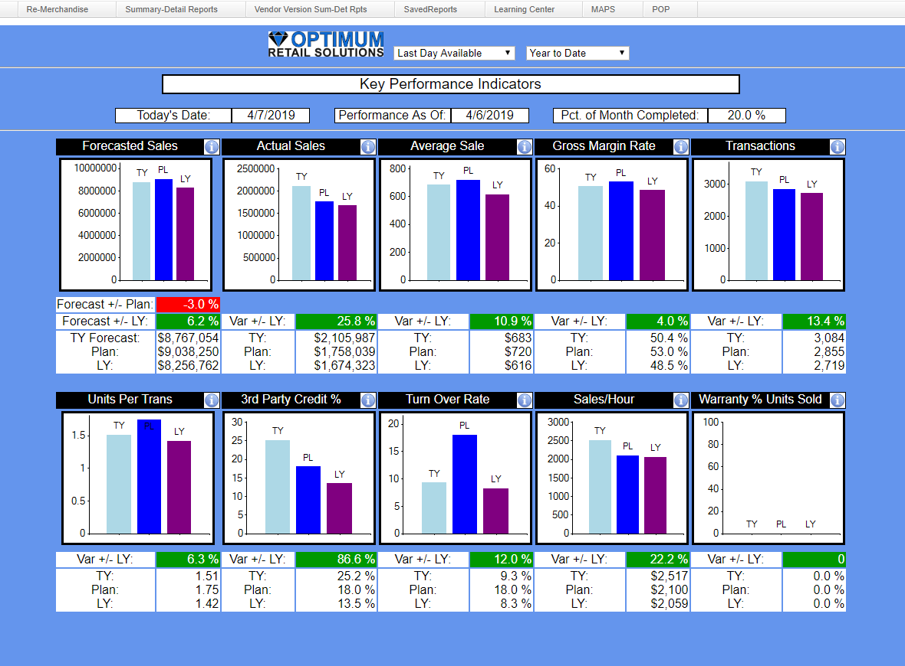
Notes:
Team behaviors – aggregate of all skills and areas for development – usually represents highest leverage opportunity
Identify gaps – daily review – determine goal and behaviors
Goal of this activity is to get the team mission-focused every day – SMEAC – situation, mission, execution, administration, command

Slide 10
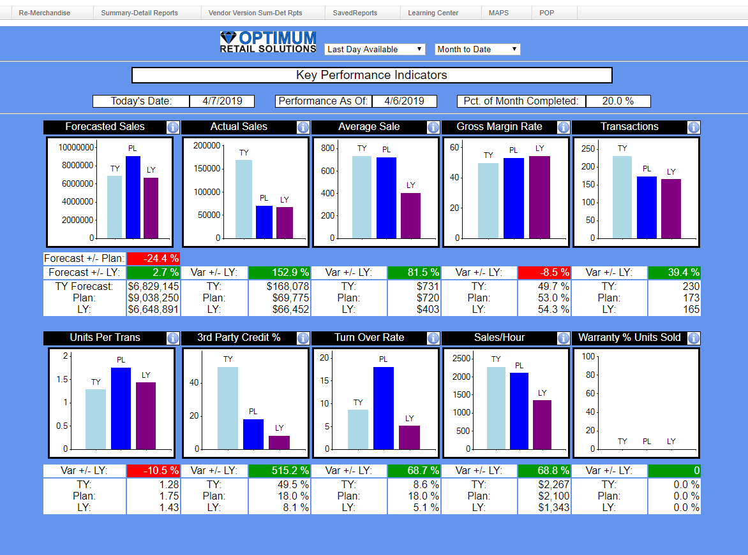

Slide 11
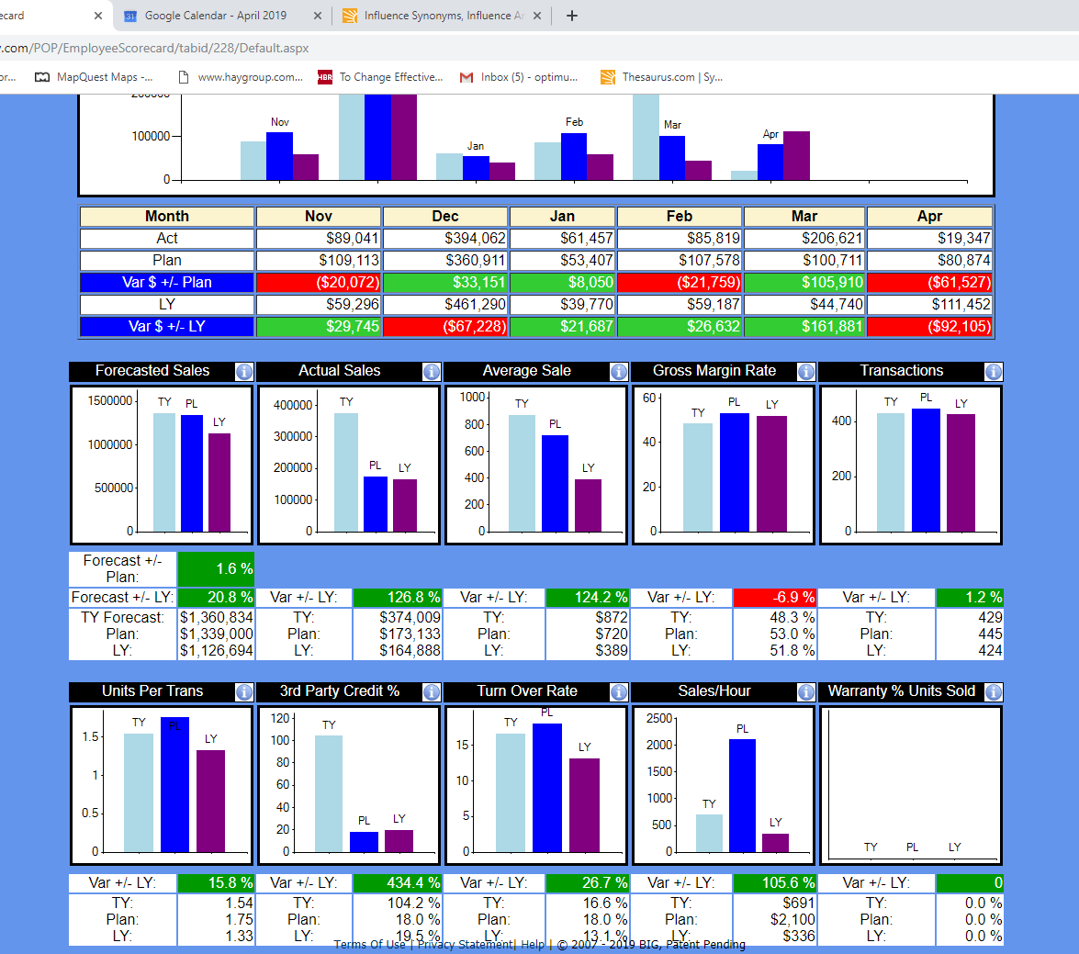
Notes:
Same process as for the team – tailored for the individual

Slide 12
Using the information
Take a position – Daily review - what do the numbers indicate?
Skill?
Hustle?
Morale?
Observe activity to confirm or correct position
Target the gaps
Take action to improve
Training
Performance Management
Motivation
Notes:
Observe against common language/behavior model
Target – there is always a gap – either better or worse than your expectation
Take action – intervene to influence – does the situation need training/perf mgmt. or motivation
Remember I said that attitude was important? Motivation matters more once skill is established

Slide 13
Closing
KPIs are numbers that indicate desired behaviors
Clear expectations include behavior, outcome and timeframe
Establish common language, behaviors and outcomes for your team
Manage evidence – Data + Observation
Take action to improve or influence
Training – Performance Management - Motivation
Notes:
Today we are going to discuss using numbers to manage people. However, more than just distinguishing if a store or salesperson met their goal or not, we want to analyze the data to determine why they missed their goal and establish an improvement plan to get better results.

Slide 14
Contact Info
Vince Rath
Owner
Optimum Retail Solutions, LLC
vince@optimumretailsolutions.com
801-907-1650

