Slide 1

How to Effectively Manage the Salesfloor
Notes:
Making the assumption that we are talking about a Sales Manager or someone acting in that capacity.

Slide 2
Today’s Objectives
Establish store and manager’s purpose
Review principles for managing a sales floor
Define elements of a clear expectation

Slide 3
The Most Important Job in the Store
The bridge between strategy and execution
Provide vision, hope and direction to the sales team
The focal point for morale, training and communication
The embodiment of the company’s culture and values; a good example
The face of management – for employees and customers.
Notes:
Review list above.
Comment: The sales manager or store manager is the position with the largest target on their back. It’s the easiest position to criticize – yet the hardest to teach.
> Often times get a lot of blame – and little recognition
So what are your priorities? (Open discussion) – After discussion – move to next slide

Slide 4
What is your store’s purpose?
How do you know when the store is on purpose?
What is the Sales Manager’s role in this?
  Move the store closer to its purpose
  Initiate the proper activity
  Evaluate performance
  Reinforce or redirect
But how is it done?
Notes:
Profit: In order to maximize profit and sales performance.
Your main goal is to keep the store / team on purpose! - Keeping the cash register ringing every minute the store is open.
Mindset:
> What are you doing “Right Now” to drive traffic or make a sale?
> What are you doing “Right Now” to get a piece of merchandise into the customers hands? – Every customer!
> What are you doing “Right Now” to improve your skill or knowledge?

Slide 5
1st things 1st
Clearly Define Performance
Connect data and behavior
Communicate, communicate, communicate
Adopt purpose driven mindset- Right Now!

Slide 6
Clearly Define Performance
Behavior
Outcome
Timeframe
Notes:
#1 – you missed goal – I know – you have to make goal – I know, ill try harder
#2 –This is the behavioral element of the equation
#3 -
#4 Manage evidence – combination of data and observation

Slide 7
Behavior
Establish common language within the team
Breakdown complex processes – i.e. sales process
Establish minimum standards within each step
  Example – Greeting -
    5 observable elements
    Achieve compliance to these standards
    Allow for individual interpretation
Why is this methodology important
Notes:
5 observable elements – positioning, smile/body language, exchange names, recipient/occasion, establish common groung

Slide 8
Outcome
Sales goal – primary outcome
  Can’t manage sales
  Have to manage activity
Key Performance Indicators
  Numbers that indicate the behaviors that produce them
  Helps prioritize Sales Manager’s efforts
    Manage Evidence
    Combination of data and observation

Slide 9
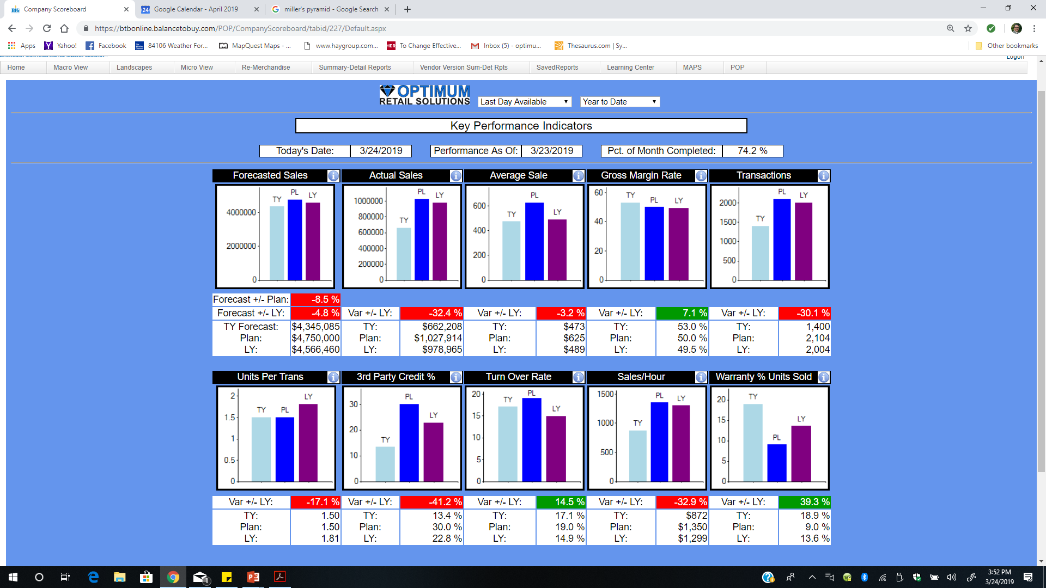

Slide 10
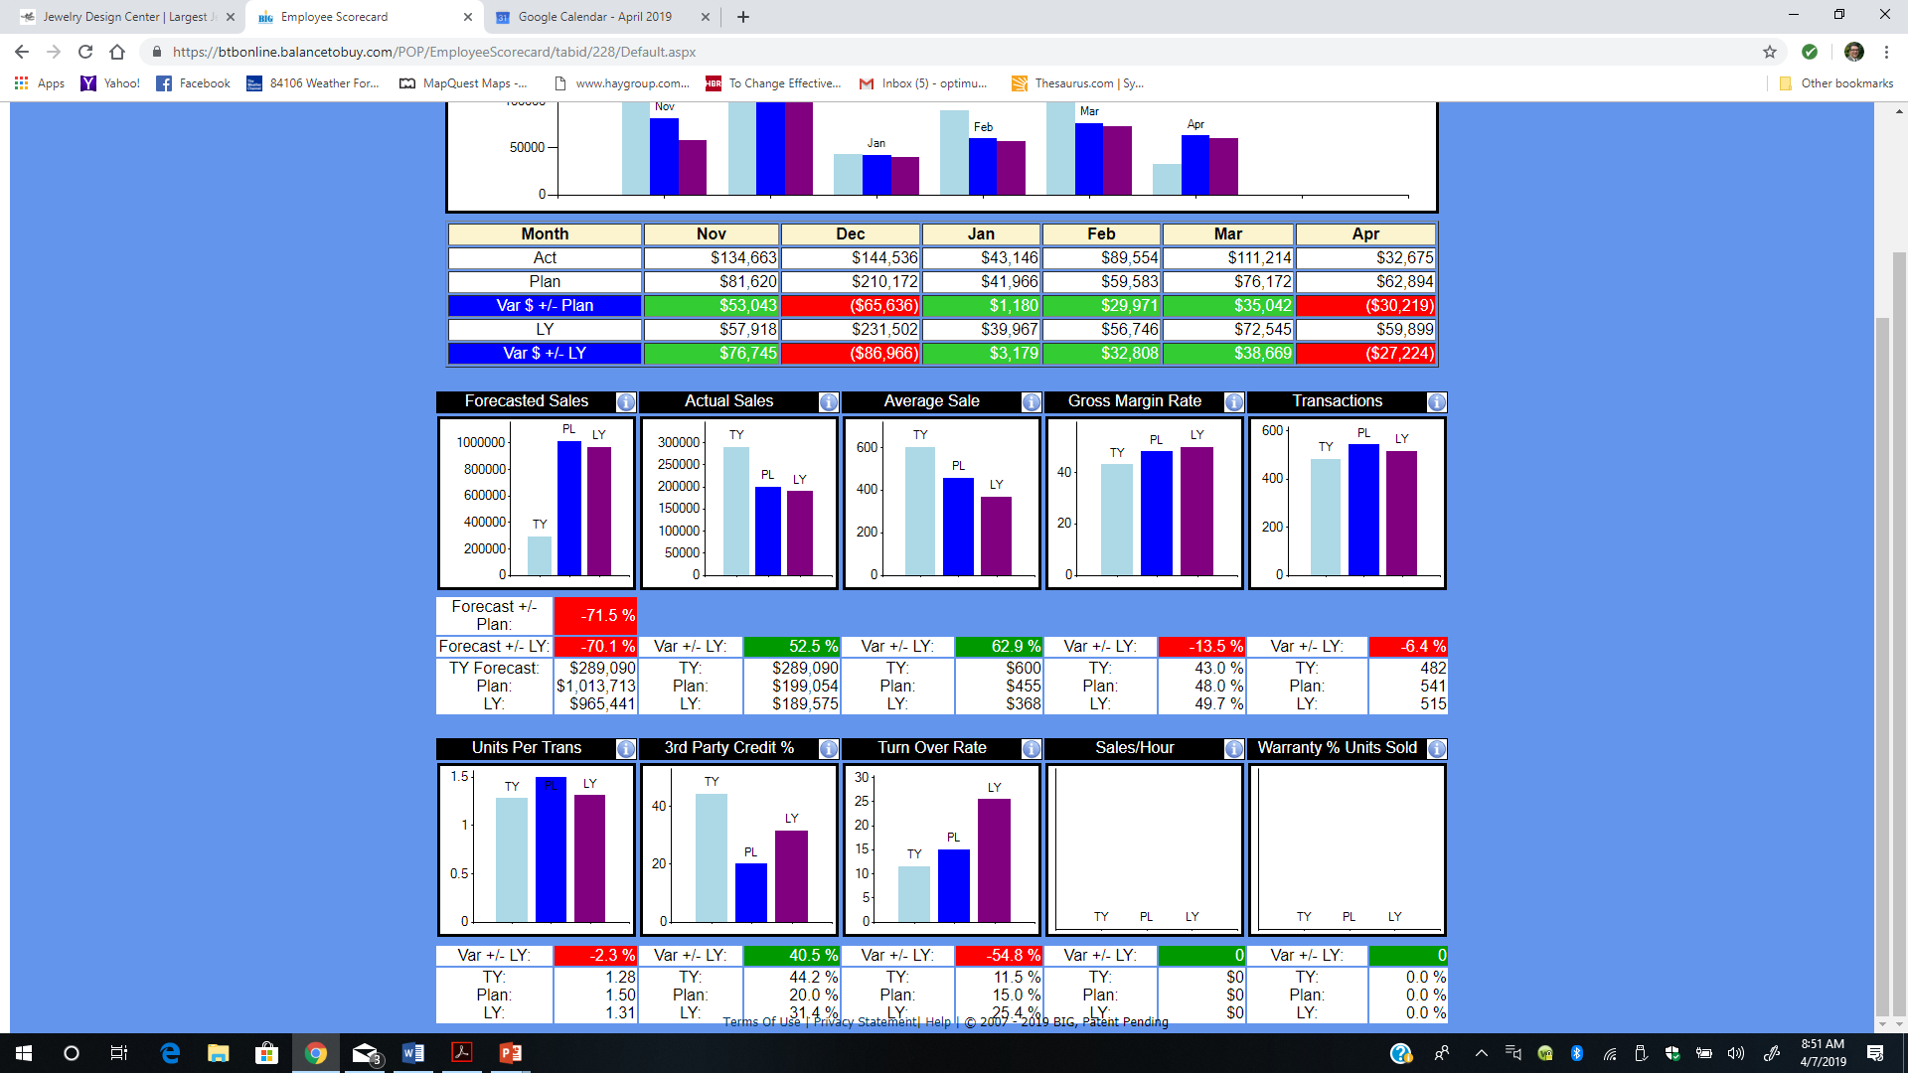

Slide 11
Putting it in Action
Begin every day with a plan
  Review MTD/YTD sales and KPI information
  Determine daily targets, contributions and behaviors
  Who needs help?
Communicate the plan
  Morning huddle
  Observations and midday checkins
Master the OTT
Notes:
Every day – before the store opens – review the numbers
Daily goal – everyone’s individual contribution – establish sales or sales driving behaviors (phone calls, building value,e tc)
Communicate the plan – every morning – prepare the team for battle – SMEAC
Huddle – midday check ins – the day’s plan is always in your mind

Slide 12
Master the OTT
Observe – Target – Take Action
  The actual process of sales floor management
Observe
  What happens vs What’s expected – common language/behavior
  Are we on purpose? Compliant? Proficient?
Target
  The Gap – there is always a gap
Take Action
  Apply Consequences
    Reinforce or redirect
Notes:
Sales manager must be present on the floor to see what happens to immediately reinforce or redirect. Can’t do the job from an office. About 75% of time on the floor. This assumes store is engaged in on-purpose activity
Consequences are neither good nor bad. Logical outcome of activity
Only consequences change behavior – Praise, intervention and punishment are types of consequences
Reinforce the good with praise/recognition – redirect the bad with coaching or punishment
Examples of escalating consequences without corrective action
In the end, you want convicted behavior. Conviction makes change long-lasting which requires less intervention. The goal is to achieve conviction around your initiatives, not compliance. We need compliance first though because conviction only appears when there is experience to support the decision.

Slide 13
Consequences
Out-process
  Praise – celebrate and reinforce best practices
  Coach – teach and reinforce best practices – 3 questions
  Correct – redirect activity – reinforce best practices
    Consider degree and duration
    Adopt appropriate style
Influence outcome
  Prompt change
  Step in – take over
  Send in - turnover

Slide 14

Contact Information
Vince Rath
Owner
Optimum Retail Solutions, LLC
vince@optimumretailsolutions.com
801-907-1650

